Slide 1
CLass 1 Group 3
Q3: What is collaborative filtering? (5 minutes)
Q5: What is matrix factorization? (5 minutes)
Ryan
Tim
Johnny
Cheef

Slide 2
WHAT IS COLLABORATIVE FILTERING?
Collaborative filtering filters information by using the interactions and data collected by the system from other users. It's based on the idea that people who agreed in their evaluation of certain items are likely to agree again in the future

Slide 3
two classes of Collaborative Filtering:
User-based (rating prediction)
measures the similarity between target users and other users.
Item-based (item recommendation / Top N)
measures the similarity between the items that target users rate or interact with and other items.
Notes:
推荐系统来说存在两大场景即评分预测（rating prediction）与Top-N推荐（item recommendation，item ranking）

Slide 4
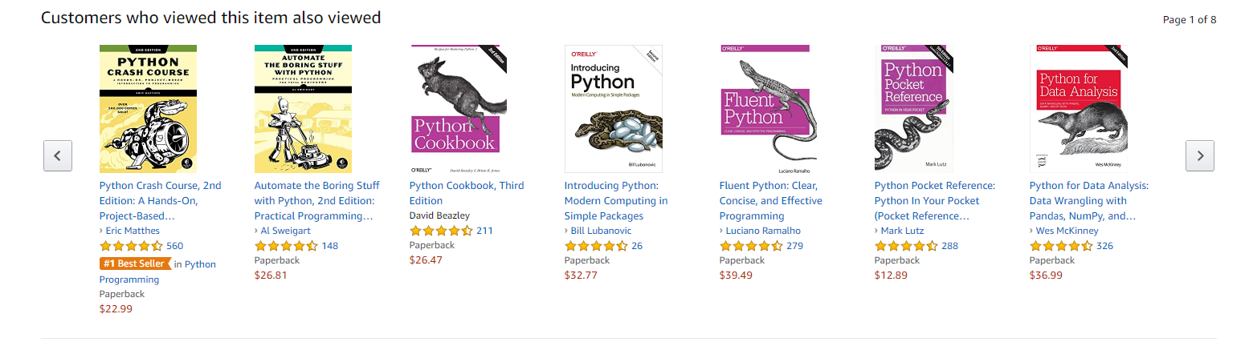
EXAMPLE

Slide 5
STEPS FOR COLLABORATIVE FILTERING?
The first step is to find similar users or items.
The second step is to predict the ratings of the items that are not yet rated by a user

Slide 6
How to measure similarity:
Pearson similarity
Jaccard similarity
Spearman rank correlation
Mean squared differences
Proximity–impact–popularity similarity

Slide 7
approaches to measure the accuracy:
Root Mean Square Error (RMSE).
Mean Absolute Error (MAE): average absolute difference between predicted ratings and actual ratings

Slide 8
Disadvantage :
Cold start : we must have enough data in the system to find match
Sparsity : most of the user do not rate most of items and hence the user-item rating matrix is “sparse”,therefore the probability of finding a set of users with significant similar rating is usually low.
First rater : can not recommend an item that has not been previously rated.

Slide 9
What is matrix factorization?
Matrix Factorization is a class of collaborative filtering algorithms used in recommendation system.
Matrix Factorization algorithm work by decomposing user-item interactive matrix into the product of two lower dimensional rectangle matrix.

Slide 10
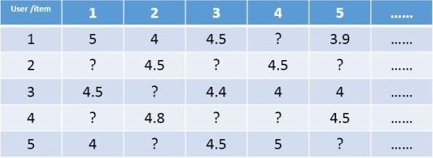
Matrix Factorization

Slide 11
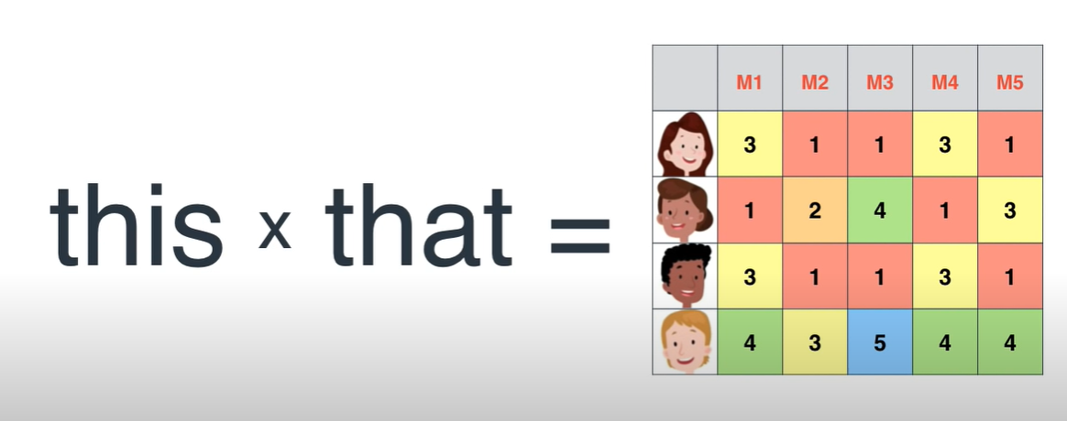
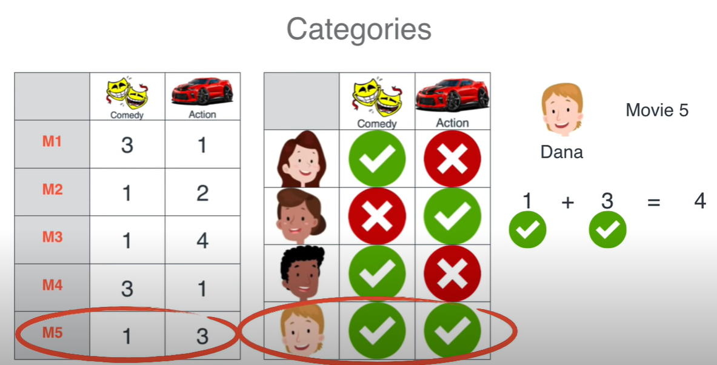
Matrix Factorization

Slide 12
Matrix Factorization
Properties:
Rij contains the rating for user i of object j
Most of the value of R is missing (90% )
R is a Lower Rank matrix, for example, movie (column) Nj and Nk might look similar.

Slide 13
Common MF Method
Singular Value Decomposition (SVD)
FunkSVD
Derivation: https://docs.google.com/document/d/1ij8rl6EgfgvsEh2UCl0iQu6AAtNV4N0DvsTZ0gySTIo/edit
Probabilistic Matrix Factorization (PMF)
Derivation: https://docs.google.com/document/d/1ij8rl6EgfgvsEh2UCl0iQu6AAtNV4N0DvsTZ0gySTIo/edit
Non-negative Matrix Factorization (NMF)

Slide 14
reference:
https://zhuanlan.zhihu.com/p/35262187
https://realpython.com/build-recommendation-engine-collaborative-filtering/#:~:text=Collaborative%20filtering%20is%20a%20technique,similar%20to%20a%20particular%20user

